Slide 1
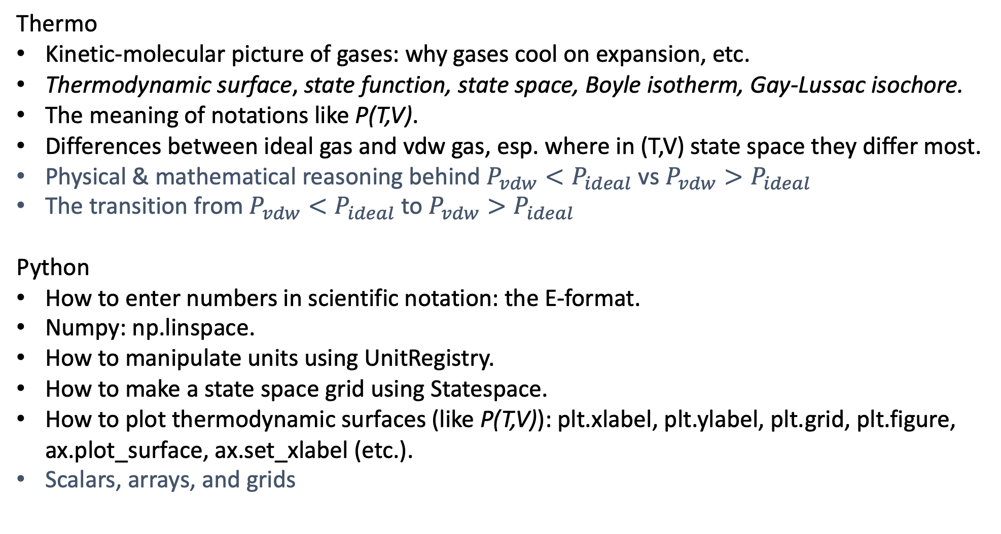
What we’ve learned …
Thermo
Kinetic-molecular picture of gases: why gases cool on expansion, etc.
Thermodynamic surface, state function, state space, Boyle isotherm, Gay-Lussac isochore.
The meaning of notations like P(T,V).
Differences between ideal gas and vdw gas, esp. where in (T,V) state space they differ most.
Physical & mathematical reasoning behind $P_{vdw}<P_{ideal}$ vs $P_{vdw}>P_{ideal}$
The transition from $P_{vdw}<P_{ideal}$ to $P_{vdw}>P_{ideal}$
Python
How to enter numbers in scientific notation: the E-format.
Numpy: np.linspace.
How to manipulate units using UnitRegistry.
How to make a state space grid using Statespace.
How to plot thermodynamic surfaces (like P(T,V)): plt.xlabel, plt.ylabel, plt.grid, plt.figure, ax.plot_surface, ax.set_xlabel (etc.).
Scalars, arrays, and grids

Slide 2
Scalars, arrays, and grids
A scalar = a single number, like a volume or temperature
V
T
A grid = T,V state space
An array = a sequence of numbers (e.g., volumes along an isotherm, or temperatures along an isochore)
In our Python code so far, we’ve generally used this naming convention
V, T, P to refer to scalars
V_array, T_array , P_array
Vgrid, Tgrid, Pgrid to refer to grids
But this convention can get clumsy, so you’ll just need to watch out for this

Slide 3
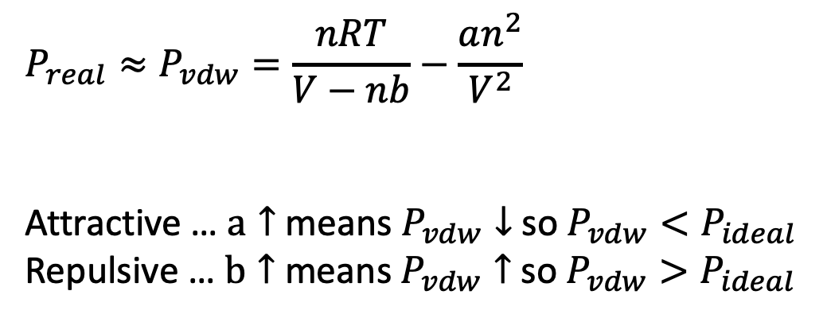

About physical vs mathematical reasoning …
$$P_{real}≈P_{vdw}=\frac{nRT}{V−nb}−\frac{an^{2}}{V^{2}}$$
Attractive … $a↑$ means $P_{vdw}↓$ so $P_{vdw}<P_{ideal}$
Repulsive … $b↑$ means $P_{vdw}↑$ so $P_{vdw}>P_{ideal}$
Intermolecular forces
Attractive … $P_{vdw}<P_{ideal}$
Repulsive … $P_{vdw}>P_{ideal}$

Slide 4
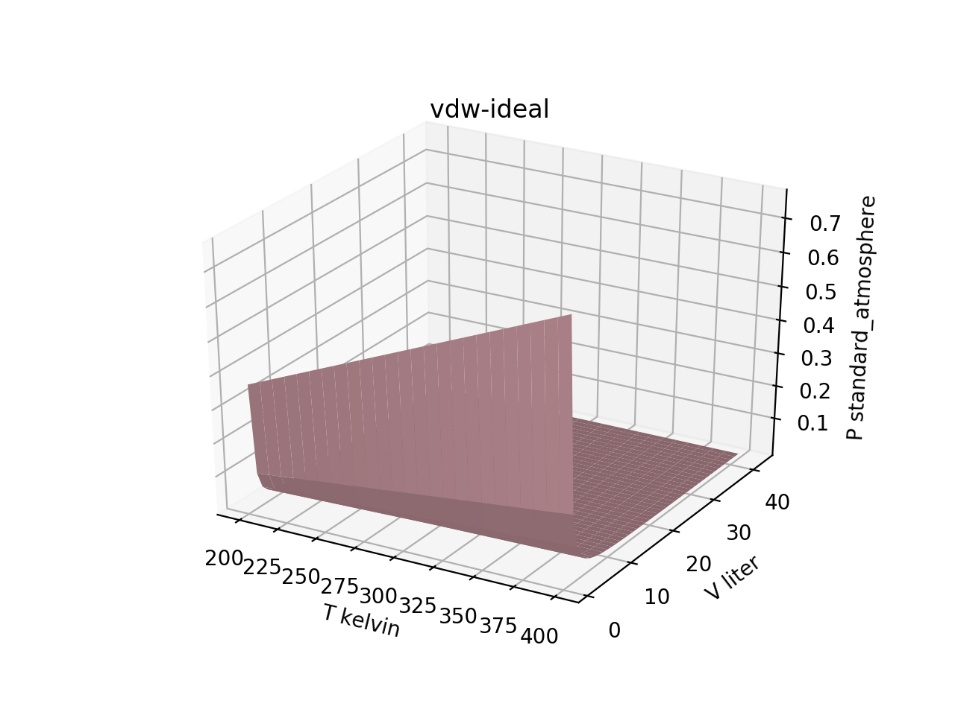
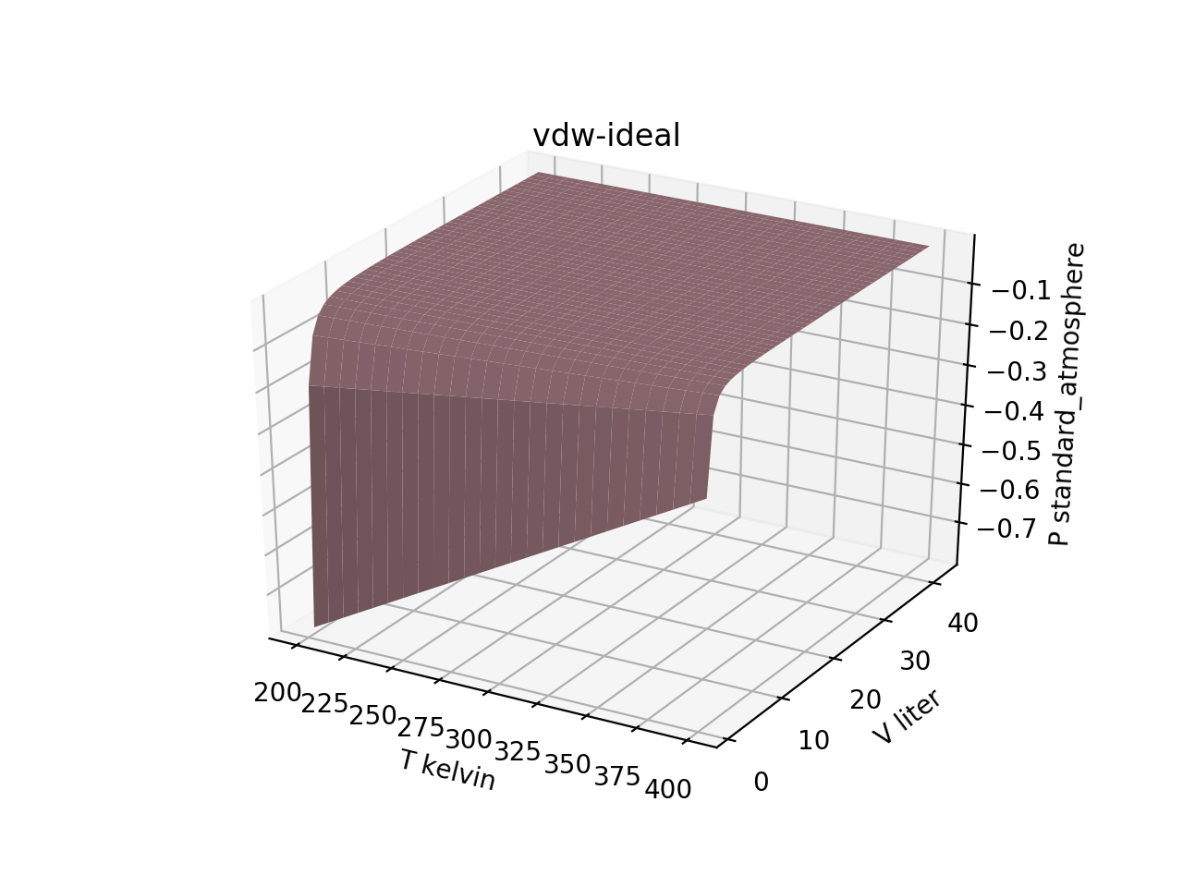
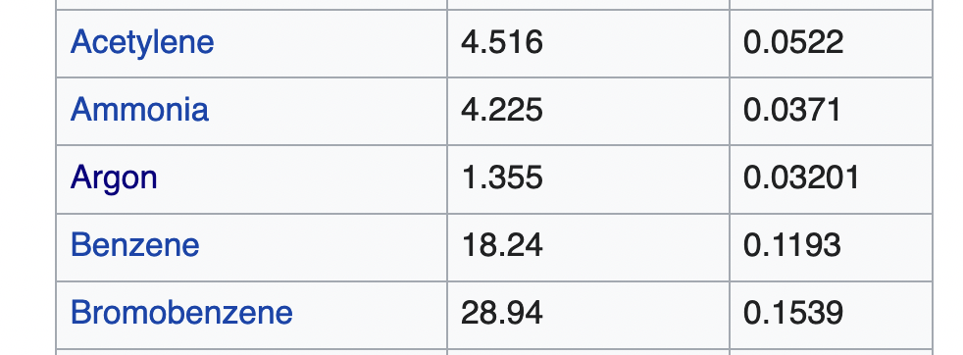
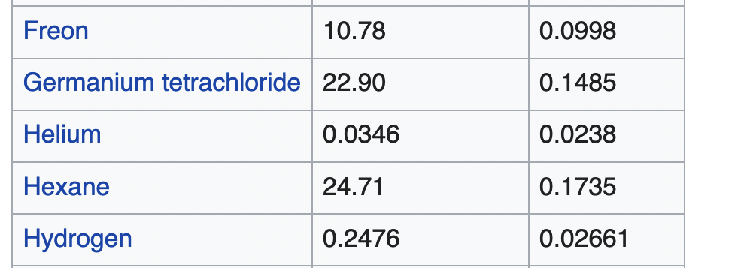
Argon gas
Helium gas
Attraction-dominant
(esp. at small volume)
Repulsion-dominant
(esp. at small volume)

Slide 5
Is there a gas that does both?
First, let’s expand our state space temperature range a bit:
Tgrid,Vgrid = Statespace([100,600,51],[1,42,42])
See anything? The temperature at which Argon switches from attraction-dominant to repulsion-dominant is called the Boyle Temperature. Why the switch? Well, physical thinking is:
Gentle (low-temperature) collision
Stick to each other (attractions)
Fast (high-temperature) collision
Bounce off each other (repulsions)

Slide 6
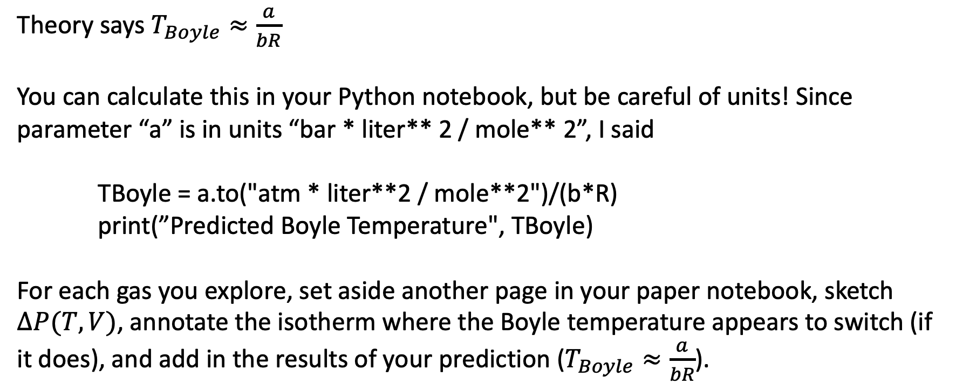
Are there other gases that do both?
Some candidates: N₂, Ne
Any way to predict this?
Theory says $T_{Boyle}≈\frac{a}{bR}$
You can calculate this in your Python notebook, but be careful of units! Since parameter “a” is in units “bar * liter** 2 / mole** 2”, I said
TBoyle = a.to("atm * liter**2 / mole**2")/(b*R)
print(”Predicted Boyle Temperature", TBoyle)
For each gas you explore, set aside another page in your paper notebook, sketch $∆P(T,V)$, annotate the isotherm where the Boyle temperature appears to switch (if it does), and add in the results of your prediction ($T_{Boyle}≈\frac{a}{bR}$).

